Slide 1


Spiritual Gifts
Introduction: Part 1
Dr. Rick Griffith • Amman International Church
BibleStudyDownloads.org

Slide 2
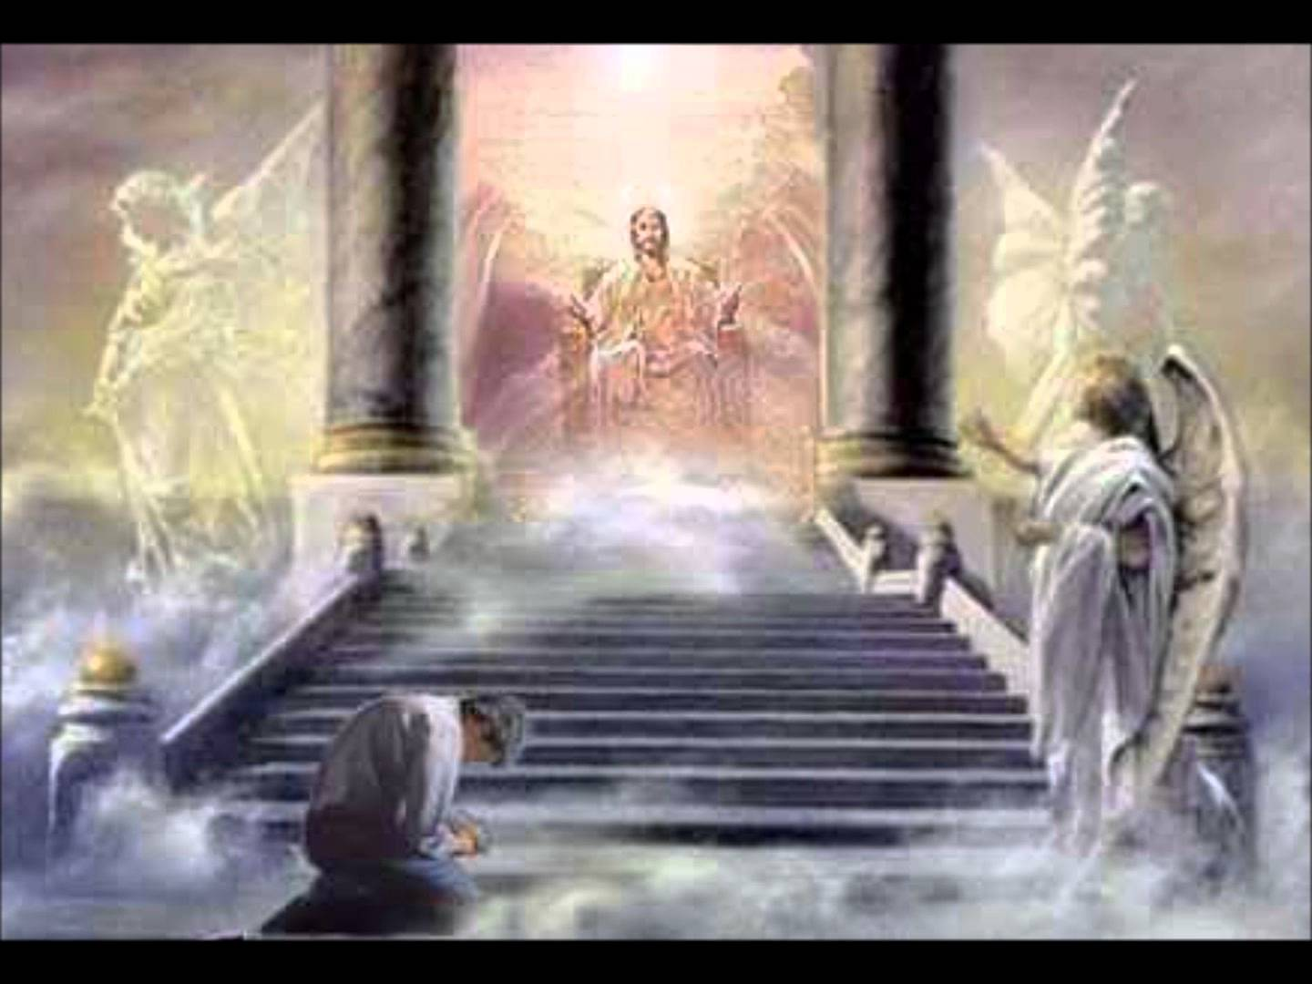
Before the Throne of God Above 1
BEFORE THE THRONE OF GOD ABOVE
Charitie Lees Bancroft | Vikki Cook
CCLI Song # 2306412
© 1997 Sovereign Grace Worship
CCLI Licence # 277507

Slide 3
Before the Throne of God Above 1
Before the throne of God above
I have a strong and perfect plea.
A great High Priest whose Name is Love
Who ever lives and pleads for me.

Slide 4
Before the Throne of God Above 1
My name is graven on His hands,
My name is written on His heart.
I know that while in heav’n He stands
No tongue can bid me thence depart.
No tongue can bid me thence depart.

Slide 5
Before the Throne of God Above 1
When Satan tempts me to despair
And tells me of the guilt within,
Upward I look and see Him there
Who made an end of all my sin.

Slide 6
Before the Throne of God Above 1
Because the sinless Savior died
My sinful soul is counted free.
For God the just is satisfied
To look on Him and pardon me.
To look on Him and pardon me.

Slide 7
Before the Throne of God Above 1
Behold Him there the risen Lamb,
My perfect spotless righteousness,
The great unchangeable I AM,
The King of glory and of grace.

Slide 8
Before the Throne of God Above 1
One in Himself I cannot die.
My soul is purchased by His blood,
My life is hid with Christ on high,
With Christ my Savior and my God!
With Christ my Savior and my God!

Slide 9
Before the Throne of God Above 1
I bow before the cross of Christ,
And marvel at this love divine,
God's perfect Son was sacrificed
To make me righteous in God's eyes.

Slide 10
Before the Throne of God Above 1
This river's depths I cannot know,
But I can glory in its flood;
The Lord Most High has bowed down low,
And poured on me His glorious love.
And poured on me His glorious love.

Slide 11

Unwrapping Your Gifts
1 Corinthians 12:1-6
Notes:
11

Slide 12

Engine trouble…
"Pride goeth before destruction
and a haughty spirit before a fall"
Notes:
A pastor, Boy Scout, and IT expert once were the only passengers on a small plane. The pilot came back to the cabin and announced that the plane was going down but there were only 3 parachutes and 4 people. The pilot added, "I should have one of the parachutes because I have a wife and 3 small children." So he took one and jumped.
The IT whiz spoke up next: "I should have one of the parachutes because I am the smartest man in the world and everyone needs me." So he took one and jumped.
At this point the pastor turned to the young Scout. With a sad smile he said, "You are young and I have lived a long life, so you take the last parachute and I'll go down with the plane."
The Boy Scout said, "Relax, Reverend, the smartest man in the world just picked up my backpack and jumped!"
Thus the proverb is true: "Pride goeth before destruction—and a haughty spirit before a fall."

Slide 13


"It's all about ME"
Notes:
People—and churches—too often get the idea that "it's all about me."

Slide 14
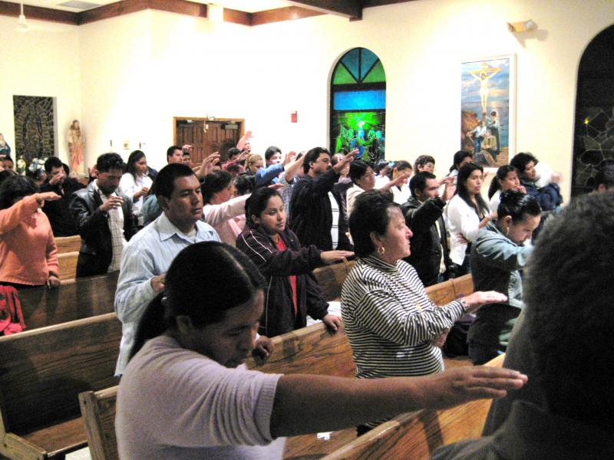
"It's all about us"
Notes:
I like that story because it's a great reminder that it's not about me—or even us.
Ultimately, all sin stems from pride—and churches can get proud over their size, worship, friendliness, music, teaching, small groups, money—or whatever.

Slide 15
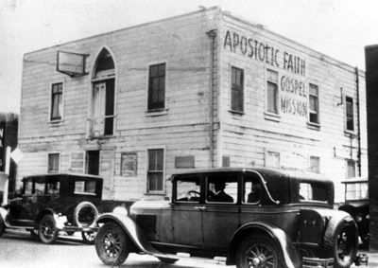
Pentecostal - 1901
Notes:
Today pride is often over whether a church is charismatic or non-charismatic.
This movement began in 1901 with Pentecostal churches speaking what they considered the biblical gift of tongues (speaking a language never learned).
Many consider the Holy Spirit to have worked in three “waves” or periods in the 20th century. Others disagree and do not attribute these periods to the Spirit at all.
Nonetheless, there were three distinct stages in the development of the experience of millions of people in the past century.

Slide 16
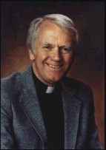
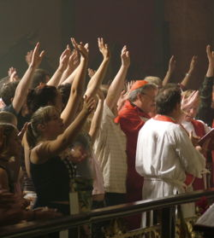
Charismatic - 1960
Dennis Bennett
Notes:
It spread to mainline churches in 1960 under Episcopal priest Dennis Bennett.

Slide 17

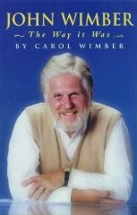

Third Wave - 1985
Notes:
In 1985 a saxophonist named John Wimber spread it into evangelical and Bible churches, including many Baptist, EFC, and now some Brethren groups.

Slide 18
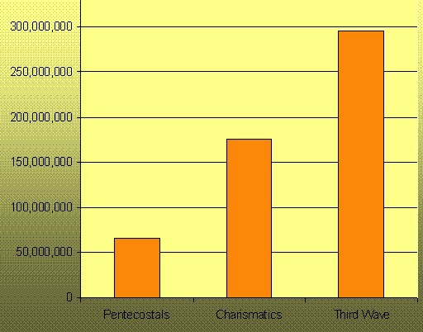
The Waves (1901-now)
Pentecostals
Charismatics
Third Wave
Notes:
Now the growth is simply amazing—and spiritual gifts are probably the most controversial of issues in the church today.

Slide 19
The Wayward Local Church
The Wayward Local Church
Reports
Questions
Division
Disorder
Difficulties
Concern
1–4
Discipline
5–6
Instruction
7–16
Carnality
3–4
Marriage 7
Worship
11–14
Factions 1–2
Incest 5
Idols 8–10
Resurrection
15
Immorality
Collection 16
Lawsuits 6
Solving church problems theologically
1 Corinthians
Notes:
We must be careful about how we teach about the Spirit since much of the teaching comes from the most troubled church in the NT at Corinth.

Slide 20

Today we will address many issues…
Basic Issues in 1 Corinthians 12
Talents v. Gifts
Why Study & Know Our Gifts
Scriptural Gift Commands
Lists of Gifts in the NT

Slide 21

Spiritual Gifts
Where should we begin studying gifts?

Slide 22

I. Understanding gifts begins with seeing Christ as God (1 Cor 12:1-3).
Father
is
is not
is not
GOD
is
is
Son
Spirit
is not

Slide 23

1 Corinthians 12:1-3 (NIV)
¹Now about spiritual gifts, brothers, I do not want you to be ignorant.
²You know that when you were pagans, somehow or other you were led astray to mute idols.
³Therefore I tell you that no one who is speaking by the Spirit of God says, "Jesus be cursed," and no one can say, "Jesus is Lord," except by the Holy Spirit.

Slide 24


Basics in 1 Cor 12:4-11
2
What
Who
Where
When
Why

Slide 25
What are spiritual gifts?
2
"…a God-given ability for service"
Charles Ryrie,
Basic Theology, 367
"…a spiritual capacity for development"
Earl Radmacher,
Sermon on Gifts

Slide 26
What are spiritual gifts?
2
Spiritual Gifts are Not:
Place of Service: the gift is the ability, not where the ability is used
Age Group Ministry: the gift is the ability, not who benefits from it
Natural Talents: the gift is the ability, not whether it came at birth
Spiritual gifts are only those mentioned in the Word of God

Slide 27
The "Who" Questions
2
Who has spiritual gifts? gives spiritual gifts? decides which gift each person should have?
Every Christian (and only Christians) has a spiritual gift (vv. 7, 11, 18).
The Spirit gives the gifts (vv. 4, 7-9, 11, 18).
The Holy Spirit decides which gift each believer receives (vv. 7, 8, 10, 11).

Slide 28
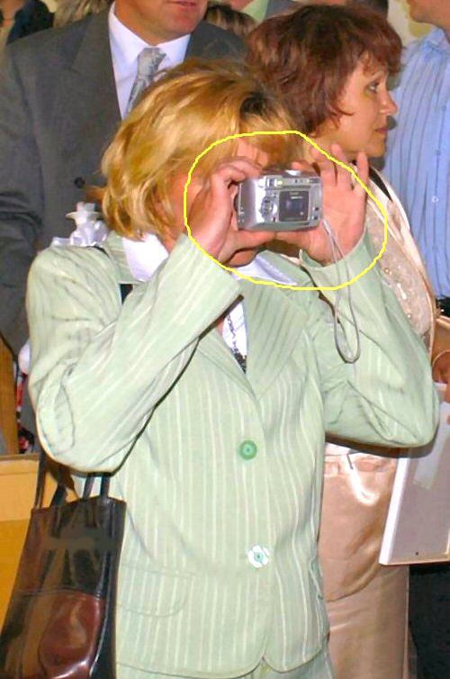
Me? Gifted?

Slide 29

Every Christian has a gift
"A spiritual gift is given to each of us so we can help each other"
(12:7 NLT)
"[The Spirit] gives them to each one, just as he determines"
(12:11 NIV)
"But our bodies have many parts, and God has put each part just where he wants it"
(12:18 NLT)

Slide 30

Have you unwrapped your gift yet?

Slide 31
Where, When & Why?
2
Where used?
When received?
Why given?

Slide 32
Every Christian got a gift when?
"A spiritual gift is given to each of us so we can help each other"
(12:7 NLT)
"[The Spirit] gives them to each one, just as he determines"
(12:11 NIV)
At salvation!
"But our bodies have many parts, and God has put each part just where he wants it"
(12:18 NLT)

Slide 33
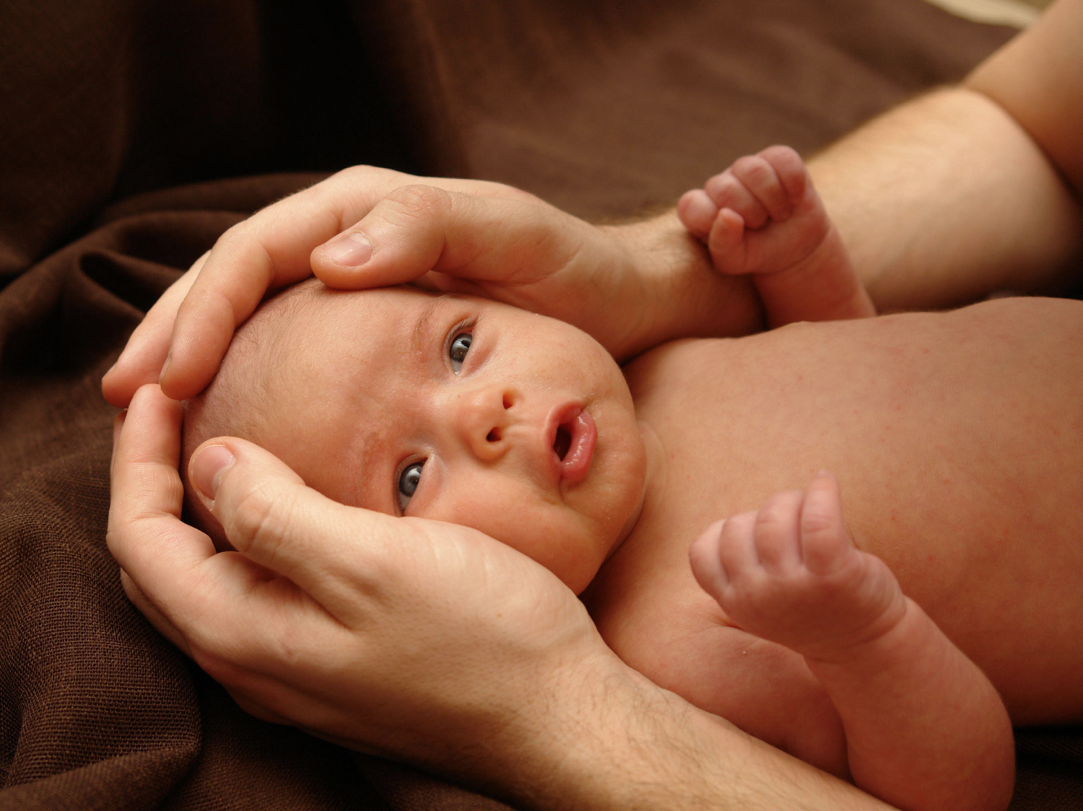
Black
Notes:
It's like a baby. I remember when our first son was born. Kurt came fully equipped! Eyes, hands, legs, and belly button... Yet his eyes couldn't focus, he couldn't control his hands, the legs seemed useless the first few months.
When you trusted Christ, the Spirit gave you an ability to use for Him. But you were a baby in Christ—equipped but ignorant and unskilled in what you can do.

Slide 34

Black
Notes:
Maybe a computer provides another analogy. You buy that computer with all the gadgets, but it takes years to understand and use all that it can do.

Slide 35
1 Corinthians 12:1-3 (NIV)
¹Now about spiritual gifts, brothers, I do not want you to be ignorant.
²You know that when you were pagans, somehow or other you were led astray to mute idols.
³Therefore I tell you that no one who is speaking by the Spirit of God says, "Jesus be cursed," and no one can say, "Jesus is Lord," except by the Holy Spirit.

Slide 36
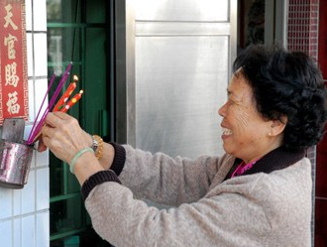
Black
Notes:
Idols say nothing but gifted persons praise Christ as God (2-3).
Some of us here used to follow idols that couldn't speak at all (2).
I've heard some of your stories how you were bound by joss sticks and the like.
A grandma on the other side of our semi-D had this problem. Once water flooded both of our homes—then the rain came the next day. As the water rose, I went out to try to prevent flooding again. She was in overdrive with her joss sticks on the porch "influenced and led away to mute idols." I put boards up to divert the rain!

Slide 37

Jesus Christ is Lord = God
Notes:
But now the Holy Spirit leads us—and He affirms Christ's deity (3).
The caution in verses 2-3 is against assuming that all manifestations that look like spiritual gifts are from God. Satan is a master counterfeiter. The gifts can be and are counterfeited by many present sects and religions. And one way to test if they're real is if they acknowledge Christ as God.
In the first century the Christians were forced to acknowledge the emperor as deity or else they would be killed. Paul said that to succumb to this was to deny the deity of Christ and deny the Spirit's leading in their lives. Same today.

Slide 38
II. Our different gifts are united in the triune God (4-6).
Father
is
is not
is not
GOD
is
is
Son
Spirit
is not
H. Wayne House, Charts of Christian Theology and Doctrine, 45

Slide 39
1 Corinthians 12:4-6 (NIV)
There are different kinds of gifts,
but the same Spirit.
There are different kinds of service,
but the same Lord.
There are different kinds of working,
but the same God
works all of them in all men.

Slide 40
GIVES
"There are different kinds of gifts,
but the same Spirit" (v. 4).
Father
is
is not
is not
GOD
is
is
Son
Spirit
is not
H. Wayne House, Charts of Christian Theology and Doctrine, 45

Slide 41
GIVES
Father
is
is not
is not
GOD
"spiritual"
is
is
Son
Spirit
is not
H. Wayne House, Charts of Christian Theology and Doctrine, 45

Slide 42
APPOINTS
"There are different kinds of service,
but the same Lord" (v. 5).
Father
is
is not
is not
GOD
is
is
Son
Spirit
is not
H. Wayne House, Charts of Christian Theology and Doctrine, 45

Slide 43
EMPOWERS
Father
is
is not
is not
"There are different kinds of working,
but the same GOD works all of them in all men" (v. 6).
is
is
Son
Spirit
is not
H. Wayne House, Charts of Christian Theology and Doctrine, 45

Slide 44
The Triune Involvement
EMPOWERS
Father
is
is not
is not
GOD
is
is
Son
Spirit
APPOINTS
GIVES
is not
H. Wayne House, Charts of Christian Theology and Doctrine, 45

Slide 45
Who has spiritual gifts?
2
The Involvement of the Whole Trinity (vv. 4-6):
God the Spirit gives (distributes) the spiritual gifts (v. 4)
God the Son assigns the place of the ministry of the gifts (v. 5)
God the Father gives the energy operative through the gifts in the place of ministry (v. 6)
(Radmacher, "Spiritual Gifts" tape, Campus Crusade for Christ)

Slide 46
Where, When & Why?
2
Where used?
When received?
Why given?

Slide 47

Talents versus Gifts
2
Issue
Talents
Gifts
Who has?
All
Christians only
How got?
Work
Grace
When got?
Varies
New birth
Who benefits?
Church
All

Slide 48
What are spiritual gifts?
2
"A spiritual gift is any ability that is empowered by the Holy Spirit and used in any ministry of the church"
Wayne Grudem,
Systematic Theology, 1016

Slide 49

The Real Issue
2
Does it really matter if we call an ability a talent or a gift?
Yes
We shouldn't add to God's Word by calling an ability a "spiritual gift" if the Bible doesn't call it a gift, but…
&
No
Both talents & gifts are:
Given by God, and
To be used for God!!

Slide 50
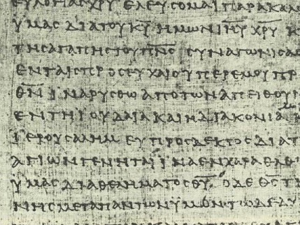

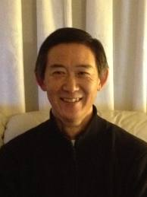

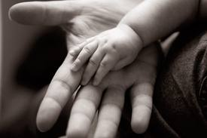
The Basis & Nature of Gifts
3
1) Charisma (ca,risma)
Roots: charis means grace (basis)
chara means joy (result)

Slide 51
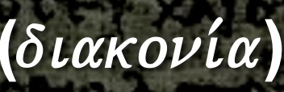
The Basis & Nature of Gifts
3
2) Diakonia (diakoni,a)
• Place of service (1 Cor. 12:5)
• Category of gifts (1 Pet. 4:11)
• "service" (NIV), ministries" (NASB)

Slide 52
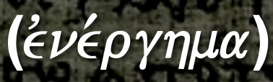
The Basis & Nature of Gifts
3
3) Energema (evne,rghma)
• Energy operating gifts (1 Cor. 12:6)
• "working" (NIV), "effects" (NASB)

Slide 53
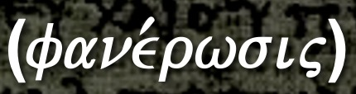
The Basis & Nature of Gifts
3
4) Phanerosis (fane,rwsij)
Evidence of the Spirit in believers
(1 Cor. 12:7)
"manifestation" (NASB, NIV),
"to make visible or known”
Secular Usage: "disclosure, announcement" (cf. 2 Cor. 4:2)

Slide 54
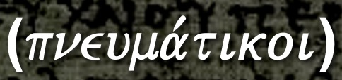

The Basis & Nature of Gifts
3
5) Pneumatikoi (pneuma,tikoi)
Spirit as the Source of gifts (1 Cor. 12:1; 14:1)
"spiritual " (NASB), literally: "spiritual things," "things of the Spirit," or simply "spirituals"
Root: "pneuma" (pneu/ma) "Spirit"

Slide 55
The Basis & Nature of Gifts
3
6) Doma (dw,ma)
Given by Christ only to the church after His Ascension (Eph. 4:7-8, 11), not during the Old Testament
Only Christians have gifts, not Old Testament saints

Slide 56

The Key Idea
Q: Where should we begin studying gifts?
A: Gifts praise the triune God—not us!

Slide 57

Why Study & Know Our Gifts?
3
1) MINISTRY TO THE CHURCH BODY - Ministering in the area of our gifts results in:
a) edification of the body— unity and interdependency (1 Cor. 14:12)
b) mobilizing the church for mission to a lost world.
c) encouraging other believers to discern and develop their gifts.

Slide 58
Why Study & Know Our Gifts?
3
2) PERSONAL FULFILLMENT - Exercising our gifts results in:
a) ministering in areas of strength, reducing frustration and wasted time.
b) assisting us in establishing priorities for study, growth, and ministry (Eph. 4:13).
c) a sense of usefulness and belonging in the body of Christ (1 Cor. 12:14-17).

Slide 59
Why Study & Know Our Gifts?
3
3) OBEDIENCE TO GOD'S WORD - Scripture gives several commands relating to gifts:
a) "Do not neglect the spiritual gift within you..." (1 Tim 4:14a).
b) "Now about spiritual gifts, brethren, I do not want you to be unaware " (1 Cor. 12:1).
c) "And since we have gifts that differ according to the grace given us, let us exercise them accordingly..." (Rom. 12:6a).
d) "As each one has received a special gift, employ it in serving one another (1 Pet. 4:10).

Slide 60

Scriptural Gift Commands
4
Teaching
Col. 3:16-- "Let the word of Christ richly dwell within you… teaching… one another…"
Evangelism
Matt. 28:19-- "Go therefore and make disciples of all nations…"
Pastor-
Teacher
Gal. 6:1-- "Brothers, if a man is caught in any trespass, you who are spiritual, restore him…"
Exhortation
Heb. 3:13a-- "But encourage one another daily…"

Slide 61
Scriptural Gift Commands
4
Adminis-
tration
1 Cor. 14:40-- "But let all things be done properly and in an orderly manner"
Faith
Heb. 11:6a-- "And without faith it is impossible to please Him…"
Giving
1 Cor. 16:2-- "On the first day of the week let each of you put aside and save [for] collections…"
Service
Gal 5:13-- "…Serve one another in love"
Showing Mercy
Col. 3:12-- "And so, as those who have been chosen of God, holy and beloved, put on a heart of compassion, kindness, humility, gentleness and patience"

Slide 62
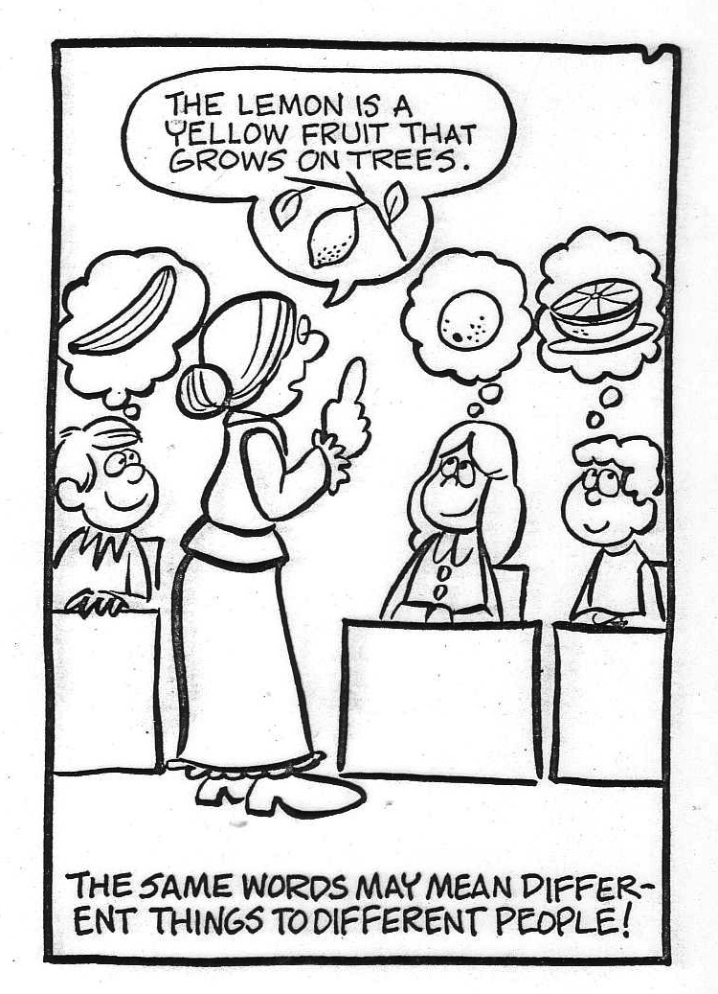
We need to define each gift
A lemon is a yellow fruit that grows on trees
The same words may mean different things to different people!

Slide 63
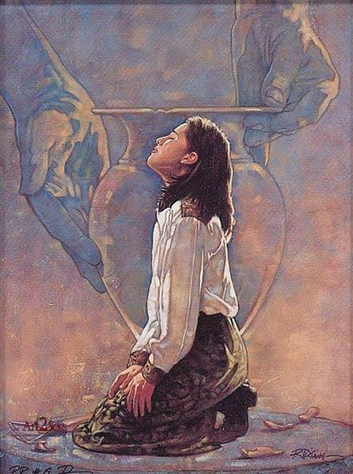
New Testament Gift Lists
6
Gifts (All) | Rom 12:6-8 | Eph 4:11 | 1 Cor 12:28 | 1 Cor 12:29-30 | 1 Cor 12:8-10
Teaching | Teaching |  | Teaching | Teaching
Evangelism |  | Evangelists
Pastor-Teacher |  | Pastor-Teachers
Exhortation | Exhortation
Administration |  |  | Administration
Faith |  |  |  |  | Faith
Giving | Giving
Service | Service |  | Helping
Showing Mercy | Mercy
Apostleship |  | Apostles | Apostles | Apostles
Wisdom |  |  |  |  | Wisdom
Knowledge |  |  |  |  | Knowledge
Prophecy | Prophecy | Prophets | Prophecy | Prophecy | Prophecy
Discerning Spirits |  |  |  |  | Discerning Spirits
Tongues |  |  | Tongues | Tongues | Tongues
Interpretation |  |  |  | Interpretation | Interpretation
Miracles |  |  | Miracles | Miracles | Miracles
Healings |  |  | Healings | Healings | Healings
Speaking
1 Pet. 4:11a
Permanent
Serving
1 Pet. 4:11b
Foundational
Eph. 2:20
Temporary
Sign
Heb. 2:4
Notes:
The NT has five distinct lists of spiritual gifts, though some would say Ephesians 4:11 describes not gifts but gifted men. I would say these list men with these gifts. Some gifts are listed only once, while prophecy shows up in every list due to its importance. The NT does not put them into categories as the NT is not a systematic theology. Instead, God wants us to use our heads to see how they fit together. It appears that 1 Peter 4:10-11 gives two main categories of gifts, so nine of the gifts are listed above based on whether one is speaking or serving while using their gift. Other gifts were foundational for the church, such as prophets and apostles who are said to form the foundation of the universal church (Eph 2:20). The chart assumes that the gift of wisdom is corollary to apostle, while knowledge and discerning spirits seem to be corollary gifts to the gift of prophecy. Finally, Hebrews 2:4 says that some sign gifts of the first generation of the church where are designed to confirm the message of the apostles. Since tongues, interpretation, miracles and healings all confirm the message of the gospel, I have put them together as sign gifts that were clearly in operation during the first generation but not clearly being given by the time of the writing of the book of Hebrews around AD 68-69.

Slide 64

1 Peter 4:10 (NIV)
"Each one should use whatever gift he has received to serve others, faithfully administering God's grace in its various forms."
Notes:
Peter speaks of each believer having a special gift. But what kind of gift to share God's grace? The next verse refers to gifts as special abilities to speak or serve the body of Christ.
____________
CH-07-Gifts-64
HS-06-Gifts-64
NS-21-1 Peter-258

Slide 65
1 Peter 4:11 (NIV)
"If anyone speaks, he should do it as one speaking the very words of God. If anyone serves, he should do it with the strength God provides, so that in all things God may be praised through Jesus Christ. To him be glory forever and ever. Amen."
Notes:
This verse seems to divide the gifts into speaking and serving in a general sense. It does not tell us which gifts fall into each category, though.
____________
CH-07-Gifts-65
HS-06-Gifts-65
NS-21-1 Peter-259

Slide 66

Categories of Gifts
(1 Peter 4:11)
Get
words
from
God
Get
strength
from
God
47
Speaking | Serving
Teaching | Administering
Evangelism | Faith
Pastor-Teacher | Giving
Encouraging | Service
 | Mercy
Notes:
66

Slide 67
Overview and Categorization of the Gifts Chart
17
SPIRITUAL GIFTS | APOSTLESHIP | PROPHECY | TEACHING | EVANGELISM | PASTOR-TEACHER | EXHORTATION |  | ADMINISTRATIONS | FAITH | GIVING | SERVICE (HELPS) | SHOWING MERCY | DISTINGUISHING SPIRITS | WORD OF WISDOM | WORD OF KNOWLEDGE | SPEAKING IN TONGUES | INTERPRETING TONGUES | MIRACLES | HEALINGS
Duration | Temporary |  | Permanent |  |  |  |  |  |  |  |  |  | Temporary
Words | Verbal |  |  |  |  |  |  | Non-Verbal |  |  |  |  | Verbal |  |  |  |  | Non-Verb
Focus | Speaking |  |  |  |  |  |  | Serving |  |  |  |  | Signifying
Category | Support |  |  |  |  |  | Service |  |  |  |  |  | Sign
Need Met | Word Taught |  |  |  |  |  | Personal Needs |  |  |  |  |  | Word Validated
Result | Leadership |  |  |  |  |  | Healthy Body Life |  |  |  |  |  | Founding the Church
Nature | Public (to many) |  |  |  |  |  | Private (to few) |  |  |  |  |  | Public (to many)
Visibility | High |  |  |  |  |  | Low |  |  |  |  |  | High
Perceived | With Honor |  |  |  |  |  | Without Honor |  |  |  |  |  | With Honor
Minister | To the Body |  |  |  |  |  | Within the Body |  |  |  |  |  | To the Body & World
Purpose to | Equip Saints |  |  |  |  |  | Encourage Saints |  |  |  |  |  | Authenticate Saints

Slide 68
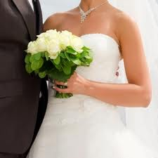
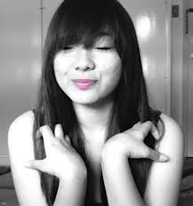
Are both marriage and celibacy spiritual gifts?
153
Grudem, 1019 (notes, 153)
1 Cor. 7:7 NLT
"But I wish everyone were single, just as I am. Yet each person has a special gift from God, of one kind or another."
It seems strange to call an ability that everyone has a "gift."

Slide 69
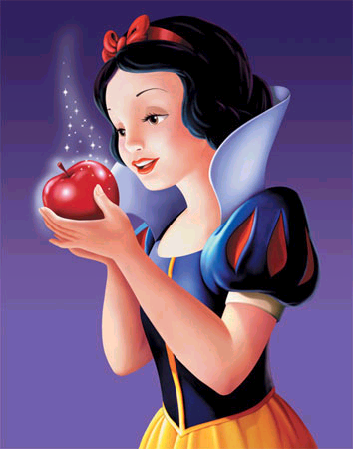
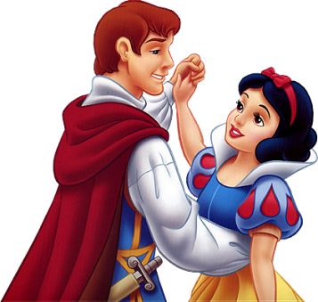
The Snow White Syndrome
Notes:
The Snow White Syndrome is the belief that a woman will not be happy until she is married. Is that true?

Slide 70
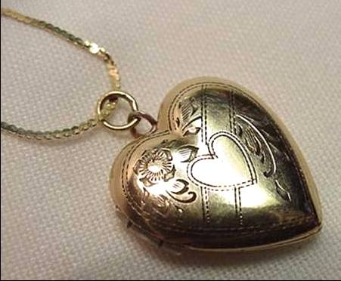
"You never know true happiness until you're married"
"… and then it's too late!"
Notes:
Experience shows that if a person is unhappy when single, this person will be unhappy when married!

Slide 71

Can a Christian lose his spiritual gift
(i.e., it is permanent)?
156
Grudem, 1025-1026, says ”yes" due to:
  Becoming unmarried
  God's will in healing
  Prophecy needing God's spontaneous revelation
  Given only for a unique need or event
  Neglect
  Grieving the Spirit
  Serious doctrinal or moral error
But is he correct?
Notes:
My response to Grudem includes the following:
Becoming unmarried—Being either single or married is still called a gift, so both are gifted.
God's will in healing—Yet we find no NT case where one with the gift of healing could not heal so nowhere is it taught that a healer loses his gift.
Prophecy needing God's spontaneous revelation—Not prophesying for a while does not indicate that one has lost the gift.
Given only for a unique need or event—Grudem says Stephen seeing heaven at his death was being gifted only for that moment (Acts 7:55), but what spiritual gift would that be?
Neglect—Why would neglecting a gift indicate withdrawal of that gift? Non-use is not the same as non-existence, though the results are similar.
Grieving the Spirit—Jesus noted in the parable of the talents that “from him who has not, even what he has will be taken away” (Matt 25:29) but Jesus did not say this about gifts. He was speaking of rewards for service to the Master.
Serious doctrinal or moral error—Certainly one’s ministry would be severely damaged here, but it argues too much to say that one’s spiritual gift would be withdrawn.
Rather than speculate on losing gifts, let us look ahead to one of the dangers of studying gifts in the next presentation. Romans 11:29 says clearly, “For the gifts and calling of God are irrevocable.” What could be clearer than this on whether gifts are withdrawn? See the next slide.

Slide 72
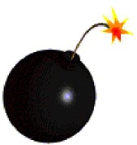
Dangers of Studying Gifts
13
9) Believing that there is any correspondence between spiritual gifts and spirituality
10) Supposing that God has withdrawn your gift since he does not use it at the present time
"For the gifts and calling of God are irrevocable" (Rom. 11:29)
Notes:
HS Presentation 07 slide 34
HS Presentation 06 slide 60

Slide 73
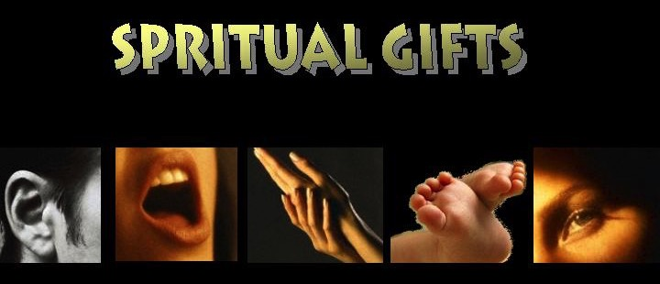
"Just as our bodies have many parts and each part has a special function, ⁵so it is with Christ's body. We are many parts of one body, and we all belong to each other"
(Romans 12:4-5 NLT)
SPIRITUAL GIFTS

Slide 74
Each One Should Use
Larry Haron

Slide 75

Each one should use
whatever gift
he has received to serve others.
Faithfully administering
God’s grace in its various forms
Each one should use,
use his gifts
Faithfully serving the Lord!
1 Peter 4:10 (NIV)

Slide 76

Holy Spirit PPT link at BibleStudyDownloads.org
Get this presentation for free!

Slide 77
Black

